Slide 1
Inertial Measuring Unit.
Vishnu Nair
Shivam Singh
Pratik Walawalkar
Thakur College of Engineering and Technology

Slide 2
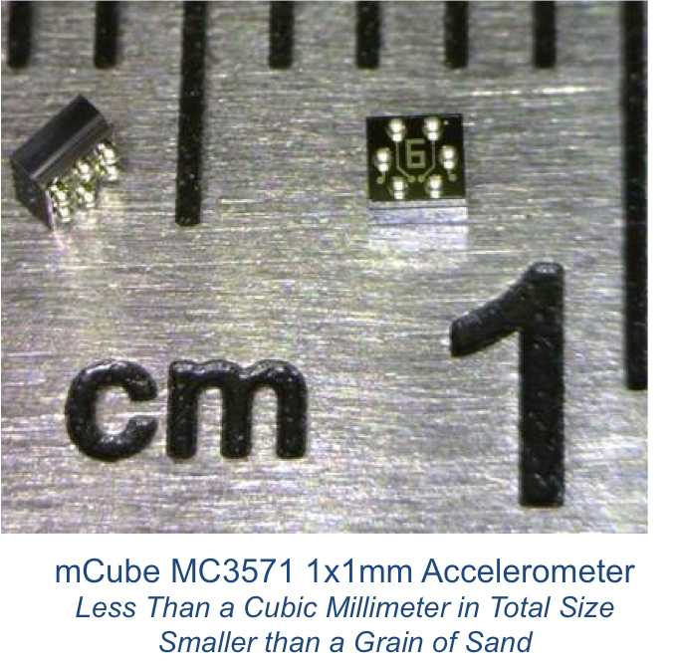
Dimensions
2x2 mm accelerometer,
1.6x1.6 mm magnetometer,
3x3 mm Gyroscope
Size of
Gyroscope > Accelerometer > Magnetometer

Slide 3
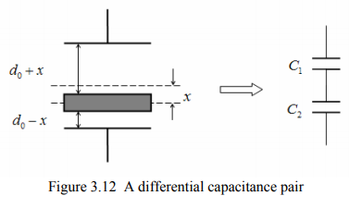

Relation of Capacitance in Gyroscope
C = $\frac{ƐA}{d0}$
C₁ = $\frac{ƐA}{d0+x}$ = $\frac{ƐA}{d0(1+(x/d0))}$ ≈ $\frac{ƐA}{d0}$ ( 1- $\frac{x}{d0} )$
C₂ = $\frac{ƐA}{d0−x}$ = $\frac{ƐA}{d0(1−(x/d0))}$ ≈ $\frac{ƐA}{d0}$ ( 1+ $\frac{x}{d0} )$
ΔC = C₂ – C₁ ₌ $\frac{ƐA}{d0}$ . $\frac{2x }{d0}$ = $\frac{2x }{d0}$ C₀
Notes:
The static sensing capacitance of the differential capacitive sensor is
C = $\frac{ƐA}{d0}$
where ε is the dielectric constant of air; S is the overlapped area of middle movable plate and the
electrodes; 0 d is the static capacitance gap between central mass and electrode.
If there is no external force applied to the central movable plate, the plate stays in the middle of
the two electrodes, and therefore the top capacitance, C1 , and bottom capacitance, C2 , are
C1 = C2 = C0
If there is an external force making the central mass move downward by x , as shown in Figure
3.12. The top capacitance, C1 , and bottom capacitance, C2 , are changed to
C₁ = $\frac{ƐA}{d0+x}$
C₂ = $\frac{ƐA}{d0−x}$
Under small deflection approximation 0 x d ,
C₁ = $\frac{ƐA}{d0+x}$ = $\frac{ƐA}{d0(1+(x/d0))}$ ≈ $\frac{ƐA}{d0}$ ( 1- $\frac{x}{d0} )$
C₂ = $\frac{ƐA}{d0−x}$ = $\frac{ƐA}{d0(1−(x/d0))}$ ≈ $\frac{ƐA}{d0}$ ( 1+ $\frac{x}{d0} )$
.
The differential capacitance change ΔC is
ΔC = C₂ – C₁ ₌ $\frac{ƐA}{d0}$ . $\frac{2x }{d0}$ = $\frac{2x }{d0}$ C₀
From Equation (3.34), we can see that for small deflection approximation, differential
capacitance change is in direct proportion to the displacement of the movable plate. That means we can
use differential capacitance change to measure the displacement of the movable plate.

Slide 4
Application of IMU in Drone
Track Current Position
Stabilize the drone
Notes:
The Essential Drone IMU
An inertial measurement unit works by detecting the current rate of acceleration using one or more accelerometers. The IMU detects changes in rotational attributes like pitch, roll and yaw using one or more gyroscopes. Some IMU on drones include a magnetometer, mostly to assist calibration against orientation drift.
A computer continually calculates the vehicle’s current position. First, it integrates the sensed acceleration, together with an estimate of gravity, to calculate the current velocity. Then it integrates the velocity to calculate the current position.
IMU Within The Flight Controller
The flight controller is made up of many components and provides many functions. It is the central brain of the drone. So, we can now see that the Gyroscope is a component of the IMU and the IMU is an essential component of a drones flight control system.
Flight controllers are not just hardware. They are also controlled by sophisticated software programs and mathematical algorithms. All components within the flight controller must work seamlessly together for the drone to navigate and fly with the utmost of stability.

Slide 5
Processing Software

Slide 6
Thank You

